Slide 1
Game Physics
Projectile & Collision

Slide 2
Projectile Motion
Projectile motion is a form of motion experienced by an object or particle.
When the object is thrown near the earth’s surface, it moves along a curved path under the action of gravity only.
It is influenced mainly by downward i.e. gravity.
It is also influenced by other factors such as drag, angle of release, force, etc.

Slide 3
Projectile Motion in Game
Projectile motion in games can be implemented via variety of software like unity, phaser, blender, etc.
It can be easily implemented by using built-in packages for rigid-body, gravity, wind, etc.
It is usually applied on objects which need to be traversed like a ball, a javelin, hammer, etc.
Its application can be seen in games like FIFA, NBA, Angry Birds, Pocket Tanks, Olympics etc.

Slide 4
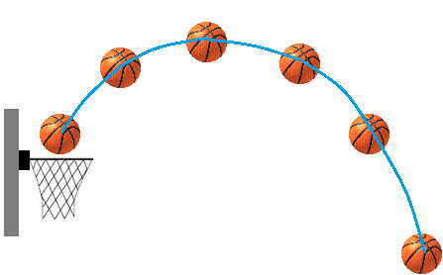
Projectile Motion in NBA

Slide 5
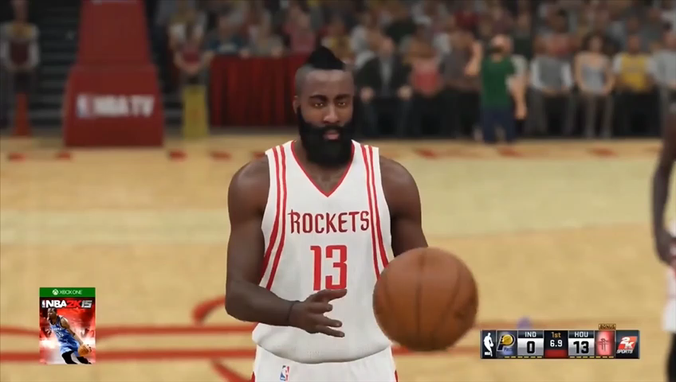

Slide 6
Collision
A collision is an isolated event in which two or more moving bodies exert forces on each other for a relatively short time.
It’s basically the intersection of two or more objects having mass and volume at a certain time and location.
There are two types of collision namely, elastic collision and inelastic collision.
Main reason of collision can be overlapping of path trajectories of two or more objects.

Slide 7
Collision in Game
Collision in game can be observed very frequently in games like collision of bullet with a body, kicking a ball, collision with other playing characters, etc.
Collision can be achieved easily in apps like unity, blender etc., by simply making the objects rigid and make the tracks of the objects such that their tracks intersect with each other at a certain time and location.
It can be seen in games like FIFA, Angry Birds, Call of Duty, Pocket Tanks, etc.

Slide 8
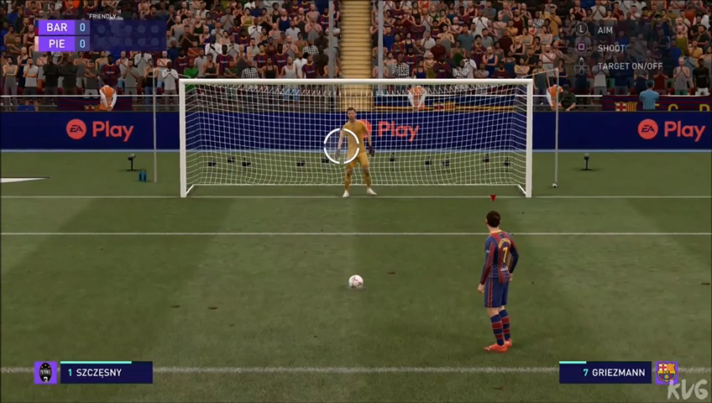

Slide 9
Thank
You

